Slide 1

JSON and SOA API Programming

Slide 2

Objectives
In this session, you will learn to:
Implement JavaScript Object Notation – JSON.
Understand and implement Application Programming Interfaces.
Implement Google Geocoding with Web Service.
Understand Security and Security API Usage.
Understand the Need of Database.

Slide 3
JavaScript Object Notation - JSON
JSON
A markup of structured data, based on the syntax of JavaScript Objects.
Its format identical to a combination of Python lists and dictionaries.
Used for data exchange between applications.
Its structure has key-value pairs.
In place of tag in XML, JSON has a set of outer curly-braces
{
"name" : "Chuck",
"phone" : { "type" : "intl",
"number" : "+1 734 303 4456"
},
"email" : {
"hide" : "yes“ }
}
Notes:
JSON is a format that allows for the markup of structured data based on the syntax of JavaScript Objects. The format of JSON is nearly identical to a combination of Python lists and dictionaries. JSON is a very natural format of data exchange between applications. JSON structure has key-value pairs. In place of tag in XML, JSON has a set of outer curly-braces.
The JSON format was inspired by the object and array format used in the JavaScript language. But since Python was invented before JavaScript, Python’s syntax for dictionaries and lists influenced the syntax of JSON. So the format of JSON is nearly identical to a combination of Python lists and dictionaries.

Slide 4
Parsing JSON
Parsing
Parsing is constructed by nesting dictionaries (objects) and lists as needed.
Parsing and data extraction code are usually simpler and more direct when using JSON.
Parsed JSON is represented as native Python objects and structures.
Notes:
We construct JSON by nesting dictionaries (objects) and lists as needed

Slide 5
Parsing JSON (Contd.)
import json
input = ''' [ {
"id" : "001",
"x" : "2",
"name" : "Chuck"
} ,
{
"id" : "009",
"x" : "7",
"name" : "Chuck"
} ]'''
info = json.loads(input)
print 'Usercount:',len(info)
for item in info:
print 'Name',item['name']
print 'Id',item['id']
print 'Attribute',item['x']
Output:
User count: 2
Name Chuck
Id 001
Attribute 2
Name Brent
Id 009
Attribute 7
Notes:
In the above program, we use the built-in json library parse the JSON and read through the data
If you compare the code to extract data from the parsed JSON and XML you will see that what we get from json.loads() is a Python list which we traverse with a for loop and each item within that list is a Python dictionary which we use the Python index operator to extract the various bits of each user.
Once the JSON has been parsed - we simply have native Python objects and structures. We don’t have to use the JSON library to dig through the parsed JSON since the returned data is simply native Python structures.

Slide 6

Just a Minute
The structure of JSON contains ________pair.

Slide 7
Just a Minute
The structure of JSON contains ________pair.
Answer:
key-value
Notes:
Solution:
Key-Value

Slide 8
Application Programming Interfaces (API)
API
API is a contract between applications that deﬁne the patterns of interaction between two application components.
In a Program we can create set of services and make it available for other programs, by publishing the API.
Set of services are available over the web of API, which is also called as Web Services.
Notes:
API is a contract between applications that deﬁnes the patterns of interaction between two application components.
When we use an API, generally one program makes a set of services available for use by other applications and publishes the APIs (i.e. the “rules”) that must be followed to access the services provided by the program.. When an application makes a set of services in its API available over the web, which is call web services.

Slide 9
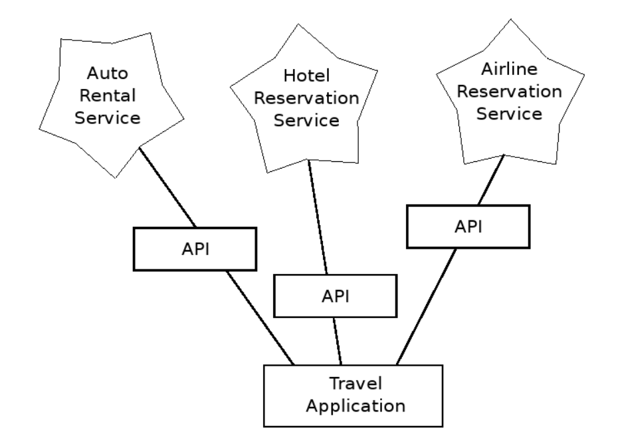
Application Programming Interfaces (API) (Contd.)
Service Oriented Architecture (SOA)
Is used where all the applications make use of the services of the other applications.
Notes:
When we begin to build our programs where the functionality of our program includes access to services provided by other programs, we call the approach a
Service-Oriented Architecture or SOA. A SOA approach is one where our overall application makes use of the services of other applications. A non-SOA approach is where the application is a single stand-alone application which contains all of the code necessary to implement the application.
We see many examples of SOA when we use the web. We can go to a single web site and book air travel, hotels, and automobiles all from a single site. The data for hotels is not stored on the airline computers. Instead, the airline computers contact the services on the hotel computers and retrieve the hotel data and present it to the user. When the user agrees to make a hotel reservation using the airline site, the airline site uses another web service on the hotel systems to actually make the reservation. And when it comes to charge your credit card for the whole transaction, still other computers become involved in the process.

Slide 10
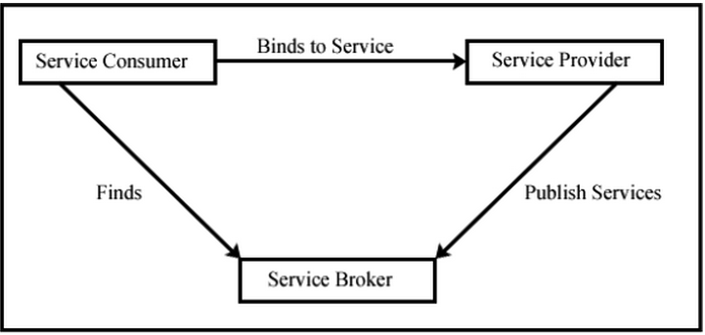
Application Programming Interfaces (API) (Contd.)
Notes:
SOA Architecture Consist of Three Building Blocks:
Service Provider : Publishes a service and registers it .
Service Broker : Enables the Service Consumers to find a service provider that offers the service required by the customer.
Service Consumer : Finds the service according to the requirement through service broker and then accesses the service provided by one or more service providers.

Slide 11

Application Programming Interfaces (API) (Contd.)
Advantages of API
Always maintains only one copy of data
The owners of the data can set the rules about the use of their data using API.
A SOA system must be carefully designed to have good performance and meet the user’s needs
Notes:
A Service-Oriented Architecture has many advantages including: We always maintain only one copy of data - this is particularly important for things like hotel reservations where we do not want to over-commit the owners of the data can set the rules about the use of their data. With these advantages, a SOA system must be carefully designed to have good performance and meet the user’s needs.

Slide 12
Google Geocoding Web Service
Google Geocoding
Excellent Web Service, offered by Google, to provide Geographic Information.
Used to search a string of online document using Web Services.
This Service is free.
Browse
to this link for more
http://maps.googleapis.com/maps/api/geocode/json?sensor=false& address=Ann+Arbor%2C+MI
Notes:
Google has an excellent web service that allows to make use of their large database of geographic information. Geocoding refer searching string of online documentation from web services. The geocoding service is free but rate limited so you cannot make unlimited use of the API in a commercial application. But if you have some survey data where an end-user has entered a location in a free-format input box, you can use this API to clean up your data quite nicely.
“When you are using a free API like Google’s geocoding API, you need to be spectful in your use of these resources. If too many people abuse the service, Google might drop or significantly curtail its free service.”

Slide 13
Google Geocoding Web Service (Contd.)
The following example will prompt the user for a search string and call the Google geocoding API to extract information from the JSON object.
import urllib
import json
serviceurl = 'http://maps.googleapis.com/maps/api/geocode/json?'
while True:
address = raw_input('Enterlocation: ')
if len(address) < 1 : break
url = serviceurl + urllib.urlencode({'sensor':'false', 'address':address})
print 'Retrieving',url
uh = urllib.urlopen(url)
data = uh.read()
print 'Retrieved',len(data),'characters'

Slide 14
Google Geocoding Web Service (Contd.)
try: js = json.loads(str(data))
except: js = None
if 'status' not in js or js['status'] != 'OK':
print '====FailureToRetrieve===='
print data
continue
print json.dumps(js, indent=4)
lat = js["results"][0]["geometry"]["location"]["lat"]
lng = js["results"][0]["geometry"]["location"]["lng"]
print 'lat',lat,'lng',lng
location = js['results'][0]['formatted_address']
print location
Notes:
The program takes the search string and constructs a URL with the search string as a properly encoded parameter and then uses urllib to retrieve the text from the Google geocoding API. Unlike a fixed web page, the data we get depends on the parameters we send and the geographical data stored in Google’s servers.
Once we retrieve the JSON data, we parse it with the JSON library and do a few checks to make sure that we received good data and then extract the information that we are looking for.

Slide 15
Google Geocoding Web Service (Contd.)
Output:
$ python geojson.py
Enter location: Ann Arbor, MI
Retrieving http://maps.googleapis.com/maps/api/
geocode/json?sensor=false&address=Ann+Arbor%2C+MI
Retrieved 1669 characters
{
"status": "OK",
"results": [{"geometry": {
"location_type": "APPROXIMATE",
"location": {"lat": 42.2808256,
"lng": -83.7430378
}},"address_components": [{"long_name": "Ann Arbor",
"types": ["locality","political"],"short_name": "Ann Arbor"}],
"formatted_address": "Ann Arbor, MI, USA",
"types": ["locality","political"
]}]}
The program takes the search string and constructs a URL with the search string as a properly encoded parameter.

Slide 16
Google Geocoding Web Service (Contd.)
Consider the following URLs to download for exploring the JSON and XML variants of the Google Geocoding API.
www.py4inf.com/code/geojson.py
www.py4inf.com/ code/geoxml.py
Notes:
You can download www.py4inf.com/code/geojson.py and www.py4inf.com/code/geoxml.py to explore the JSON and XML variants of the Google geocoding
API.

Slide 17
Security and API Usage
API Key
Used by vendor’s API to understand who is using their services and how much each user is using.
Used as a part of POST data or perhaps as a parameter on the URL when calling the API.
OAuth
Used to sign requests over the Internet.
Notes:
“API key” is needed to make use of a vendor’s API to understand who is using their services and how much each user is using. Sometimes API key is available with the key as part of POST data or perhaps as a parameter on the URL when calling the API.
Some times the vendor wants increased assurance of the source of the requests and so they add expect your service to send cryptographically signed messages using shared keys and secrets.
A very common technology that is used to sign requests over the Internet is called OAuth. To avoid writing an OAuth implementation from scratch by reading the speciﬁcation, download various OAuth libraries from OAuth website.

Slide 18
Just a Minute
______is a Contract between applications that defines the patterns of interaction between two application components.

Slide 19
Just a Minute
______is a Contract between applications that defines the patterns of interaction between two application components.
Answer:
API
Notes:
Solution:
API

Slide 20
Activity
Activity : Parsing JSON Data
Problem Statement:
Write a program to read data from JSON file.
Prerequisite: For this activity please refer myjson.json available in “Data_File_For_Students” folder.
Notes:
Solution:
Prerequisite: For this activity you need to use myjson.json which is available with Data_File_For_Students
In order to do this activity, you need to perform the following tasks:
Create a Python empty project.
Use json library to use load() to parse the json data.
Task 1: Create a Python empty project:
Step 1: Open NetBeans 8.0.2.
Step 2: Click File menu.
Step 3: Select New Project.
Step 4: Select Python from Categories list and Python Project from Projects list.
Step 5: Click Next button.
Step 6: On New Python Project dialog box set the Project Name as CR_Session16_Activity01.
Step 7: Select project Location by clicking Browse button.
Step 8: Click Finish button.
Task 2: Use json library to use load() to parse the json data:
Step 1: Type the following code:
import json
with open('myjson.json') as data_file:
data=json.load(data_file)
for item in data:
print('Name: '+ item['name'])
print('Id: '+ item['id'])
print('Attribute: '+ item['x'])
Step 2: Run the program.

Slide 21

Database - Introduction
How do I store the data permanently and ensure that it is secure?

Slide 22
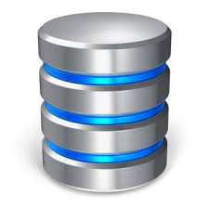
Database – Introduction (Contd.)
Database
Is a file that is organized for storing data.
Is stored on permanent storage it can store far more data than a dictionary.
Maintains its performance by building indexes as data is added to the database.
Examples : Oracle, MySQL, Microsoft SQL Server, PostgreSQL, and
SQLite.
SQLite
Is designed to be embedded into other applications to provide database support within the application.
Notes:
A database is a file that is organized for storing data. Most databases are organized like a dictionary in the sense that they map from keys to values. The biggest
difference is that the database is on disk (or other permanent storage), so it persists after the program ends. Because a database is stored on permanent storage, it can
store far more data than a dictionary, which is limited to the size of the memory in the computer.
Database software maintains its performance by building indexes as data is added to the database to allow the computer to jump quickly to a particular entry.
There are many different database systems which are used for a wide variety of purposes including: Oracle, MySQL, Microsoft SQL Server, PostgreSQL, and
SQLite. We focus on SQLite in this book because it is a very common database and is already built into Python. SQLite is designed to be embedded into other
applications to provide database support within the application

Slide 23
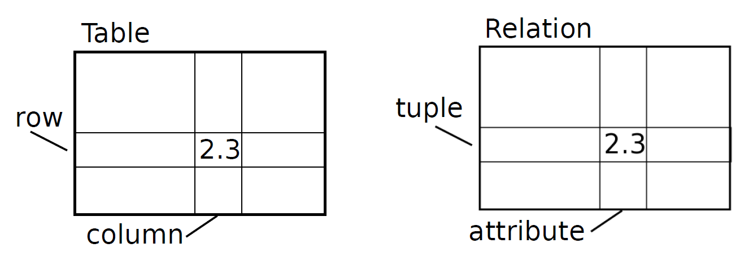
Database - Concepts
Database Structure
Consists of tables – rows and columns.
Technically
Table – Relation
Row – Tuple
Column - Attribute
Notes:
When you first look at a database it looks like a spreadsheet with multiple sheets.
The primary data structures in a database are: tables, rows, and columns.
In technical descriptions of relational databases the concepts of table, row, and column are more formally referred to as relation, tuple, and attribute, respectively

Slide 24
Just a Minute
Table is technically referred to as _________.

Slide 25
Just a Minute
Table is technically referred to as _________.
Answer:
Relation
Notes:
Solution:
Relation

Slide 26
Activity
Activity : Implementing Google Geo Coding API
Problem Statement:
Write a program to print out the Latitude and Longitude of a given place and also the two-character country code from the retrieved data. Add error checking so the program does not trace back if the country code does not exist. Run the program by searching for “Atlantic Ocean” and make sure it can handle locations that are not in any country.
Notes:
Solution:
In order to do this activity, you need to perform the following tasks:
Create a Python empty project.
Use urllib and JSON library to avail service URL API.
Task 1: Create a Python empty project:
Step 1: Open NetBeans 8.0.2.
Step 2: Click File menu.
Step 3: Select New Project.
Step 4: Select Python from Categories list and Python Project from Projects list.
Step 5: Click Next button.
Step 6: On New Python Project dialog box set the Project Name as CR_Session16_Activity02.
Step 7: Select project Location by clicking Browse button.
Step 8: Click Finish button.
Task 2: Use urllib and JSON library to avail service URL API:
Step 1: Type the following code:
import urllib
import json
serviceurl = "http://maps.googleapis.com/maps/api/geocode/json?“
while True:
address = raw_input("Enter location: ")
if len(address) < 1 : break
url = serviceurl + urllib.urlencode({"sensor":"false", "address": address})
print("Retrieving"+ url)
uh = urllib.urlopen(url)
data = uh.read()
print("Retrieved"+str(len(data))+"characters")
try:
js = json.loads(str(data))
except:
js = None
if 'status' not in js or js['status'] != 'OK':
print("==== Failure To Retrieve ====")
print(data)
continue
print(json.dumps(js, indent=4))
lat = js["results"][0]["geometry"]["location"]["lat"]
lng = js["results"][0]["geometry"]["location"]["lng"]
print("lat"+str(lat)+"lng"+str(lng))
location = js['results'][0]['formatted_address']
print(location)
Step 2: Run the program.

Slide 27
Summary
In this session, you learned that:
JSON is a format that allows for the markup of structured data based on the syntax of JavaScript Objects.
API is a contract between applications that deﬁnes the patterns of interaction between two application components.
SOA approach is one, where our overall application makes use of the services of other applications.
Geocoding refers to searching string of online document from web Services.
“API key” is needed to make use of a vendor’s API to understand who is using their services and how much each user is using.
Database is a file for storing and organizing data.

